Slide 1


Predicting Credit-Worthy Consumer Loans
Linda Ju

Slide 2
What is Peer-to-Peer (“P2P”) Lending?

Slide 3
What is Peer-to-Peer (“P2P”) Lending?
Needs to Borrow Money

Slide 4
What is Peer-to-Peer (“P2P”) Lending?
Needs to Borrow Money
Have Extra Money to Invest

Slide 5
What is Peer-to-Peer (“P2P”) Lending?
Fund Loan
Needs to Borrow Money
Have Extra Money to Invest

Slide 6
What is Peer-to-Peer (“P2P”) Lending?
Fund Loan
Needs to Borrow Money
Repay Loan with Interest
Have Extra Money to Invest

Slide 7
What is Peer-to-Peer (“P2P”) Lending?
Fund Loan
Online P2P Lending Platform
Needs to Borrow Money
Repay Loan with Interest
Have Extra Money to Invest

Slide 8

Objective
As a P2P lender with limited funds:
which loans are credit-worthy?

Slide 9
Data

Slide 10
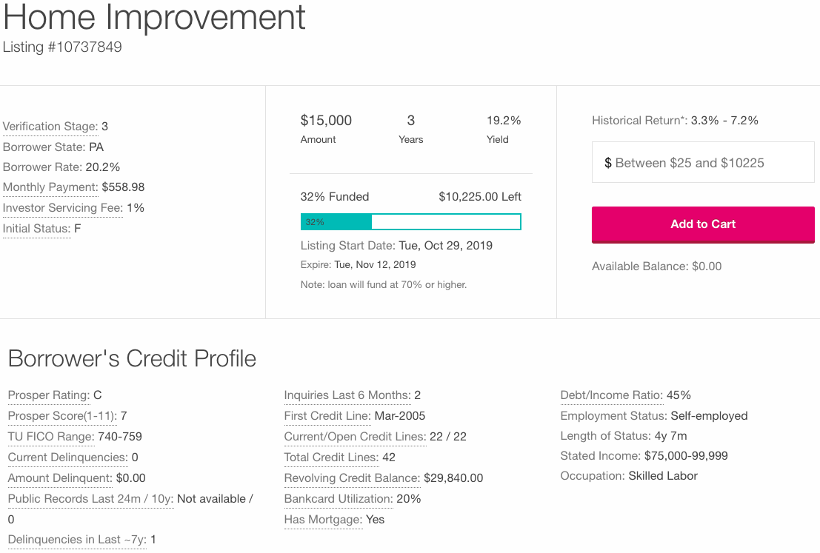
Data

Slide 11


Methodology
Maximize Return on Investment (“ROI”):
$$\left(\frac{\text{Interest} \text{from} \text{Good} \text{Loans}−\text{Amount} \text{Lost} \text{on} \text{Bad} \text{Loans}}{\text{Total} \text{Amount} \text{Invested} \text{in} \text{Good} \text{Loans} \text{and} \text{Bad} \text{Loans}} \right) × 100\%$$

Slide 12
Results and Conclusion
Investing Based on Random Forest Model:
6.38% ROI

Slide 13
Results and Conclusion
Investing Based on Random Forest Model:
6.38% ROI
Compared to -10.67% ROI if randomly choosing loans!

Slide 14

Future Enhancements
Refine ROI formula
Model more features
Loan-specific features
Macroeconomic conditions
Transformations
Train more models/methods

Slide 15
Questions?

Slide 16
Appendix

Slide 17
Distribution of Target
1: “Good” Loan
0: “Bad” Loan
Full Dataset
Count of Good Loans: 17,554
Count of Bad Loans: 5,878
Total Observations: 23,432
Train Dataset (Oversampled)
Count of Good Loans: 11,267
Count of Bad Loans: 11,267
Total Observations: 22,534
Validation Dataset
Count of Good Loans: 2,808
Count of Bad Loans: 941
Total Observations: 3,749
Test Dataset
Count of Good Loans: 3,479
Count of Bad Loans: 1,208
Total Observations: 4,687

Slide 18
Distributions of Features

Slide 19
Distributions of Features

Slide 20

Methodology
“Good” Loans (Credit-Worthy Loans)
Pays off completely and on-time
Assume full repayment of principal plus interest
Comparison
Repayment Behavior
Return Assumption
“Bad” Loans
Defaults or Delinquent Payments (more than 60 days late)
Assume maximum loss (zero return and no recovery)
Maximize Return on Investment (“ROI”) Metric:
$$\left(\frac{\text{Interest} \text{from} \text{Good} \text{Loans}−\text{Amount} \text{Lost} \text{on} \text{Bad} \text{Loans}}{\text{Total} \text{Amount} \text{Invested} \text{in} \text{Good} \text{Loans} \text{and} \text{Bad} \text{Loans}} \right) × 100\%$$

Slide 21
Chosen Model: Random Forest
Tuning Parameters
n_estimators = 100
max_depth = 6
Probability threshold = 95%
Feature Importance
BorrowerRate
BorrowerAPR
ProsperRating_num
StatedMonthlyIncome
Term

Slide 22
Results and Conclusion
Investing Based on Random Forest Model
Invest in:
55 loans
$25 each
Total investment of $1,375
All loans repay with interest
Total return of $1,462.78
6.38% ROI
Compared to -10.67% ROI if randomly choosing loans!

Slide 23
Comparison to Other Investment Options

Slide 24
Random Forest Predicted Good Loans

Slide 25
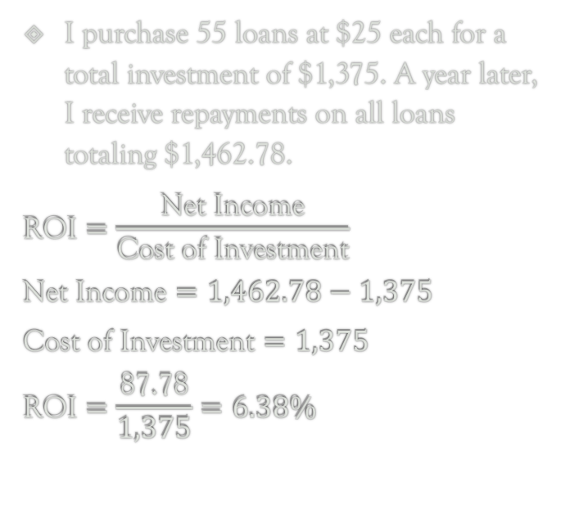
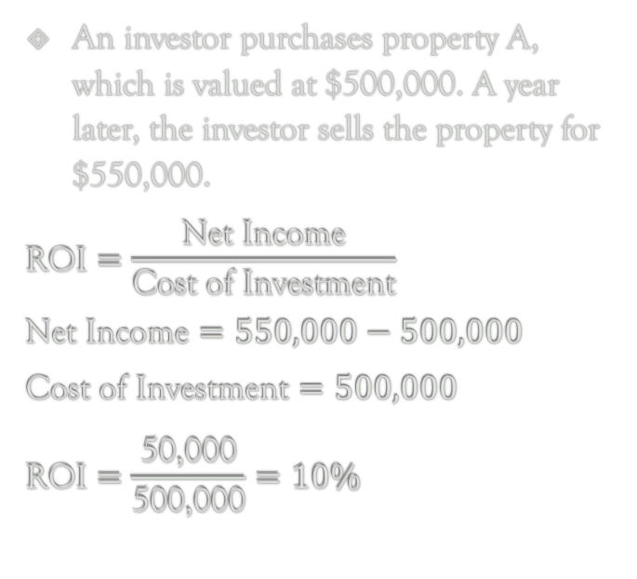
Sample ROI Calculation
Finance Example
Investing Based on
Random Forest Model
An investor purchases property A, which is valued at $500,000. A year later, the investor sells the property for $550,000.
$$\text{ROI}=\frac{\text{Net} \text{Income}}{\text{Cost} \text{of} \text{Investment}}$$
$$\text{Net} \text{Income}=550,000−500,000$$
$$\text{Cost} \text{of} \text{Investment}=500,000$$
$$\text{ROI}=\frac{\text{50,000}}{\text{500,000}}=10\%$$
I purchase 55 loans at $25 each for a total investment of $1,375. A year later, I receive repayments on all loans totaling $1,462.78.
$$\text{ROI}=\frac{\text{Net} \text{Income}}{\text{Cost} \text{of} \text{Investment}}$$
$$\text{Net} \text{Income}=1,462.78−1,375$$
$$\text{Cost} \text{of} \text{Investment}=1,375$$
$$\text{ROI}=\frac{\text{87.78}}{1,375}=6.38\%$$

Slide 26
Other Models Trained
In addition to Random Forest:
XGBoost
max_depth = 5
n_estimators = 100
Probability threshold = 97%
KNN
n_neighbors = 54
Probability threshold = 93%
Logistic Regression
C = 15
Probability threshold = 99%
Naïve Bayes
Probability threshold = 99%

Slide 27
Comparison to Other Models (ROI)

Slide 28
Comparison to Other Models (Invest Amount)

Slide 29
Comparison to Other Models (Confusion Matrices)
Random Forest
XGBoost
Actual
Good
1208 | 0
3424 | 55
Actual
Good
1203 | 5
3267 | 212
Bad
Bad
Bad
Good
Bad
Good
Predicted
Predicted
KNN
Logistic Regression
Actual
Good
1201 | 7
3283 | 196
1208 | 0
3473 | 6
Actual
Good
Bad
Bad
Bad
Good
Bad
Good
Predicted
Predicted

Slide 30
Comparison to Other Models (Confusion Matrices)
Naïve Bayes
Actual
Good
1062 | 146
2363 | 1116
Bad
Bad
Good
Predicted

Slide 31
Comparison to Other Models (ROC Curves)

